Slide 1


Predicting Data Science Salaries

Slide 2
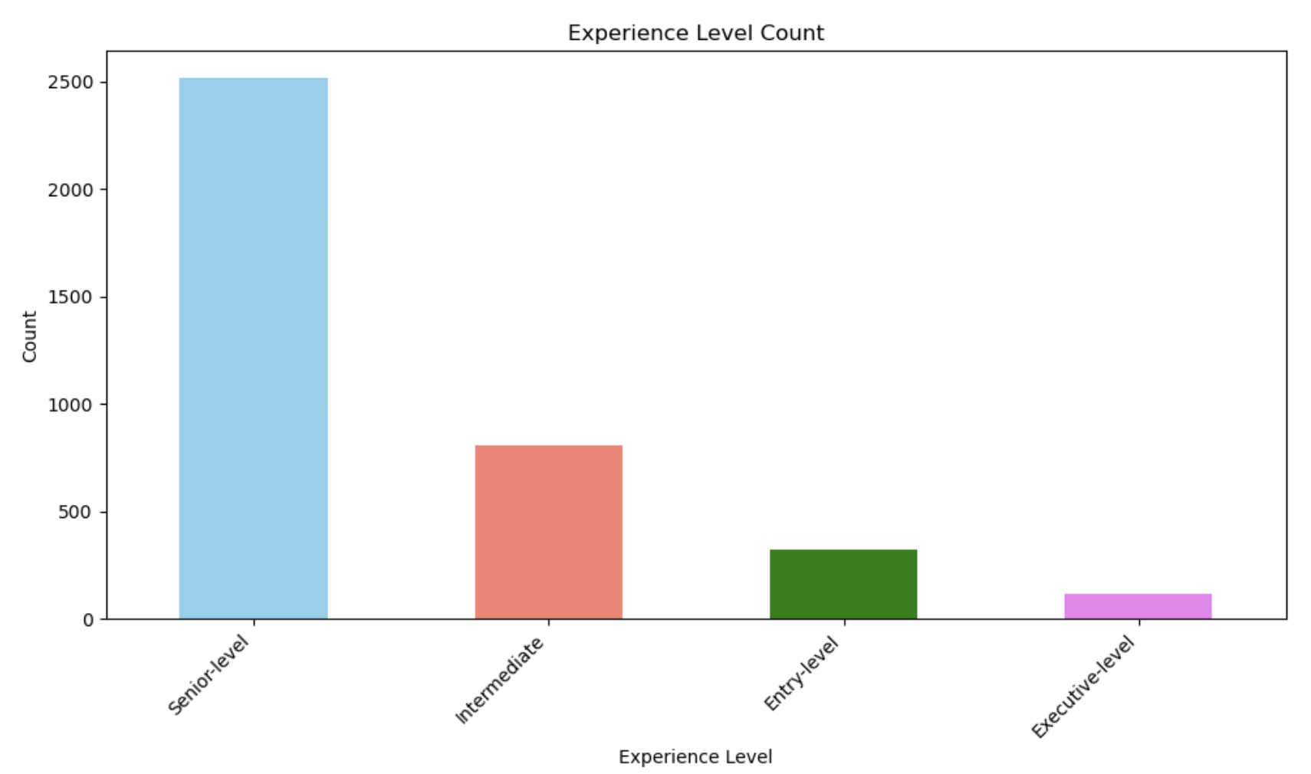
Count of number of Entries for Each Experience Level
Experience

Slide 3
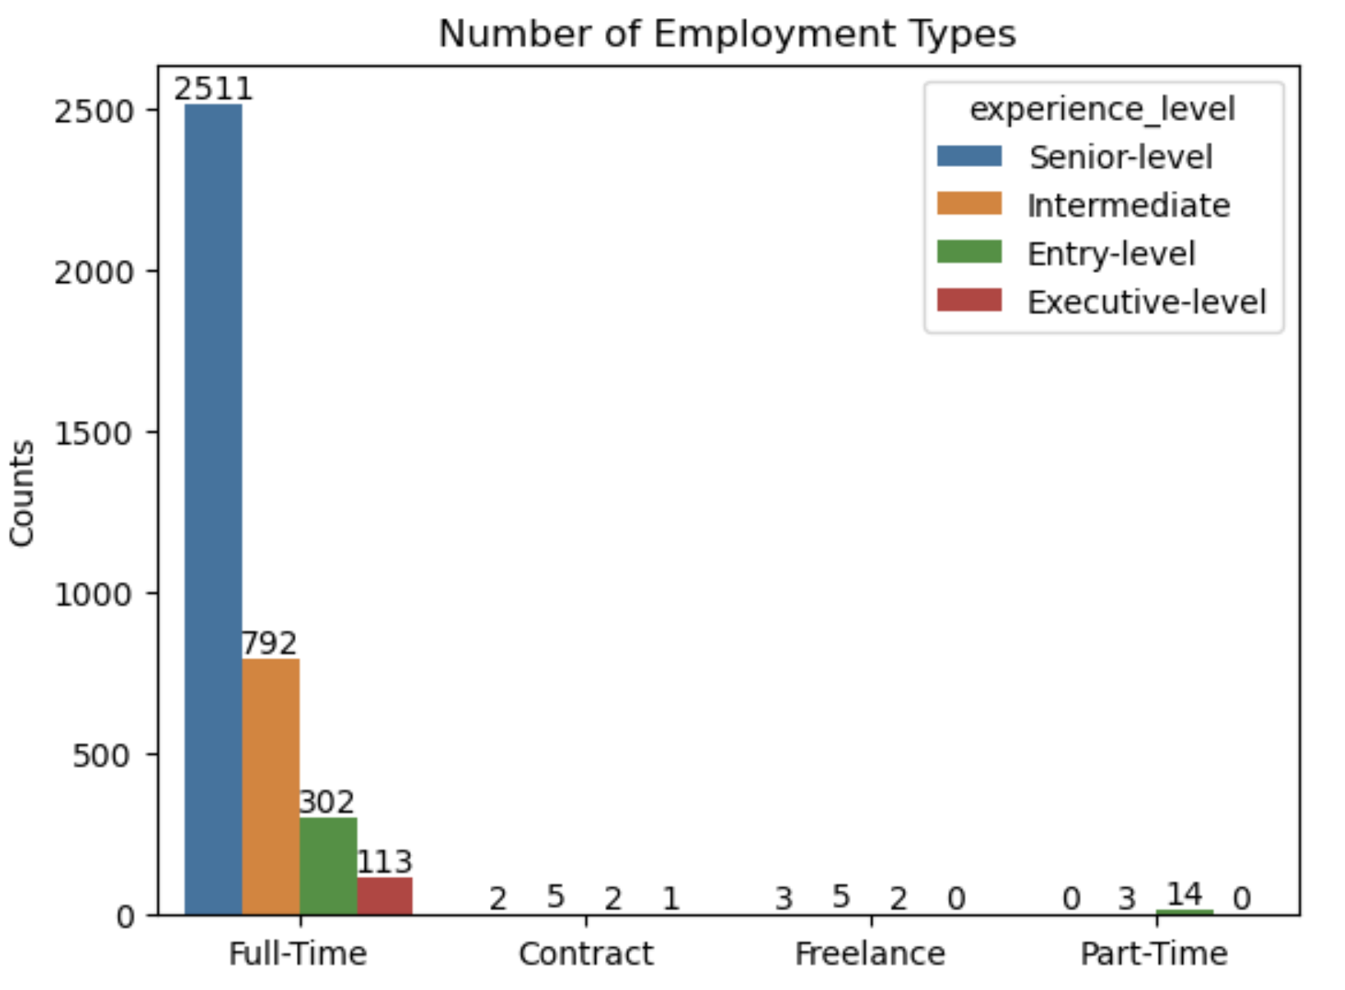
Count of Employment Type by Experience Level

Slide 4

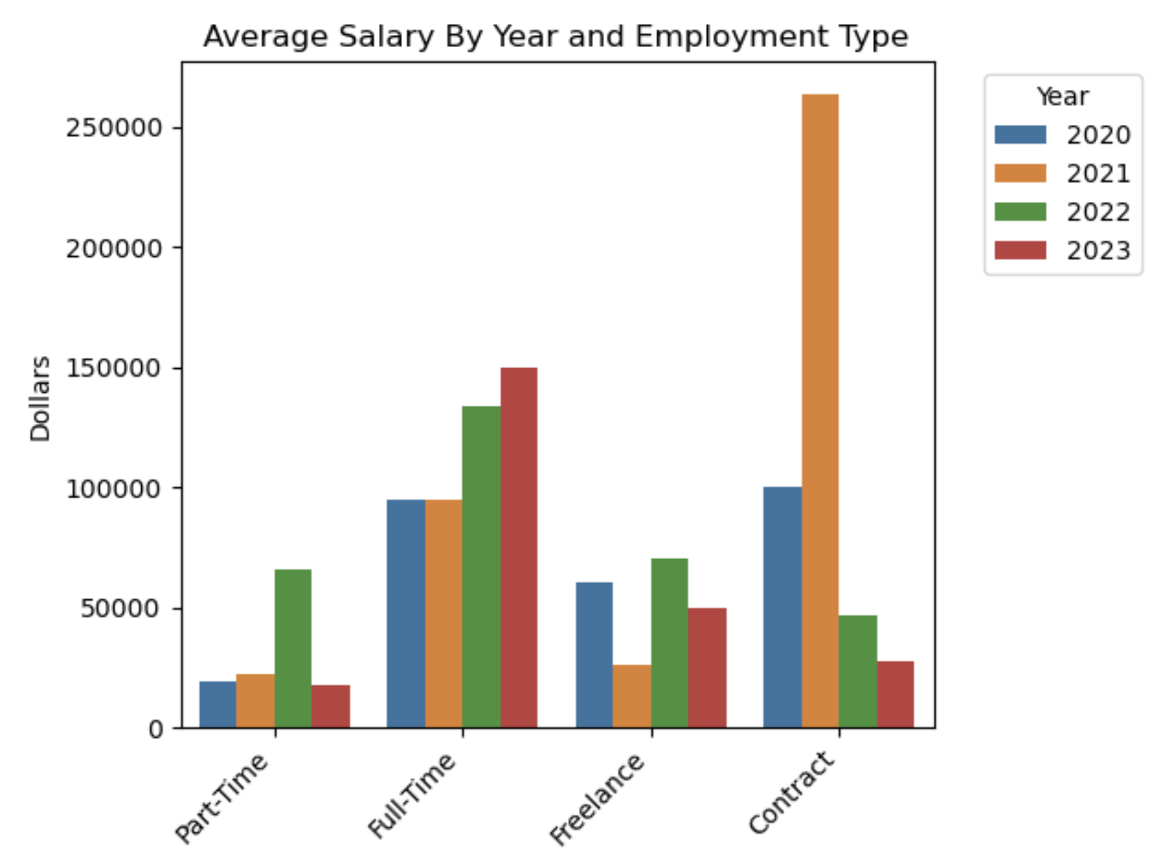



Average Salary by Year and Employment Type

Slide 5
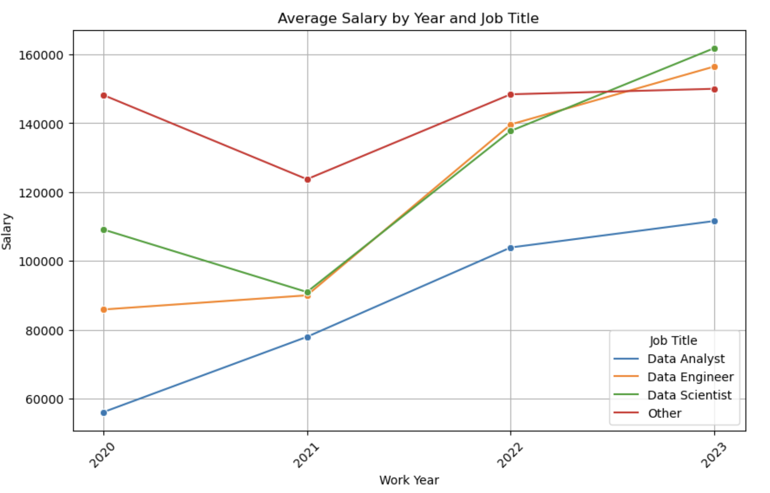
Average Salary By Year and Job Title

Slide 6
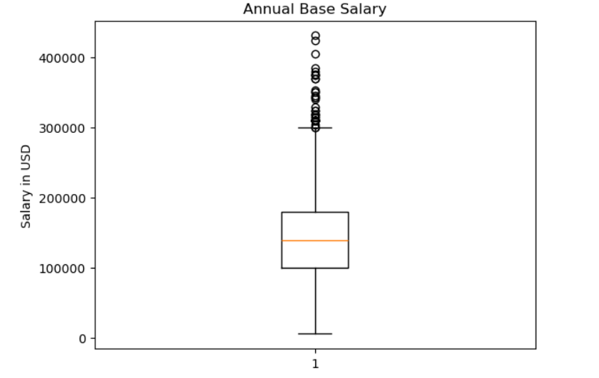
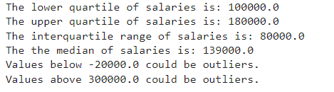
Data Cleaning

Slide 7
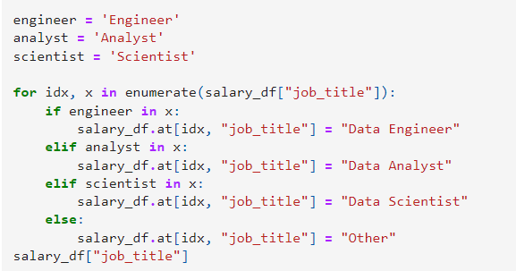
Data Cleaning Continued
Reduced to full time employees and 22-23 using the loc function
Categorized employee residency as US or other

Slide 8
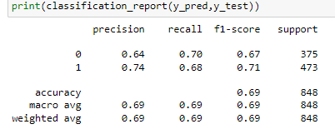
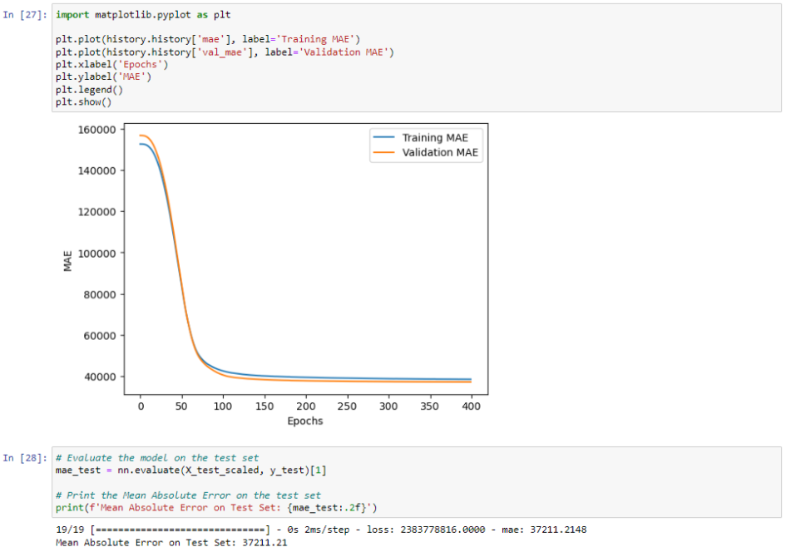
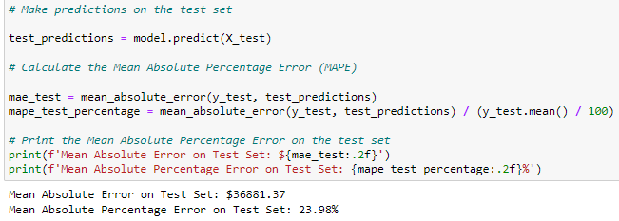
Data Model Optimization: Which model and why?
K-Nearest Neighbors (KNN) Model
Neural Network Model
Random Forest Model

Slide 9
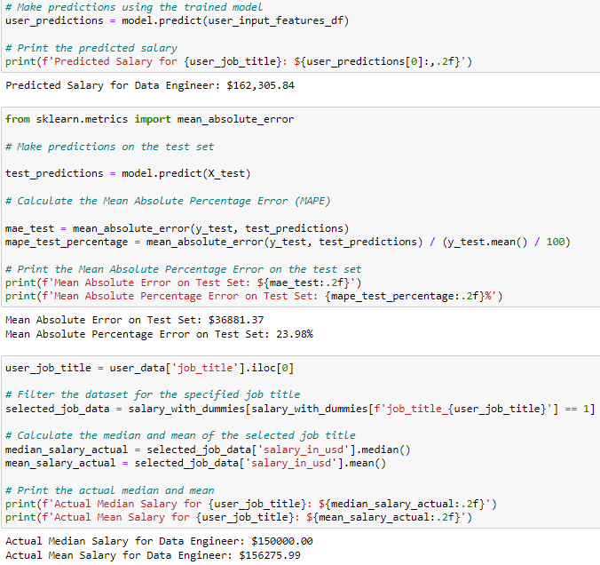
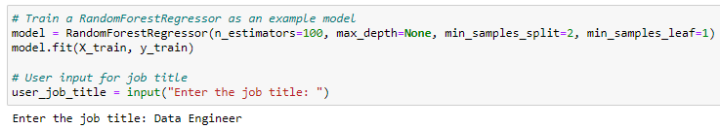
Following the numbers

Slide 10

Thanks for listening! Questions are welcomed here

